Slide 1

Estefanía Crespo Bardera and Manuel Montoya Catala Multimedia Information Management Carlos III University of Madrid 17-3-2015
Website searching using IR

Slide 2

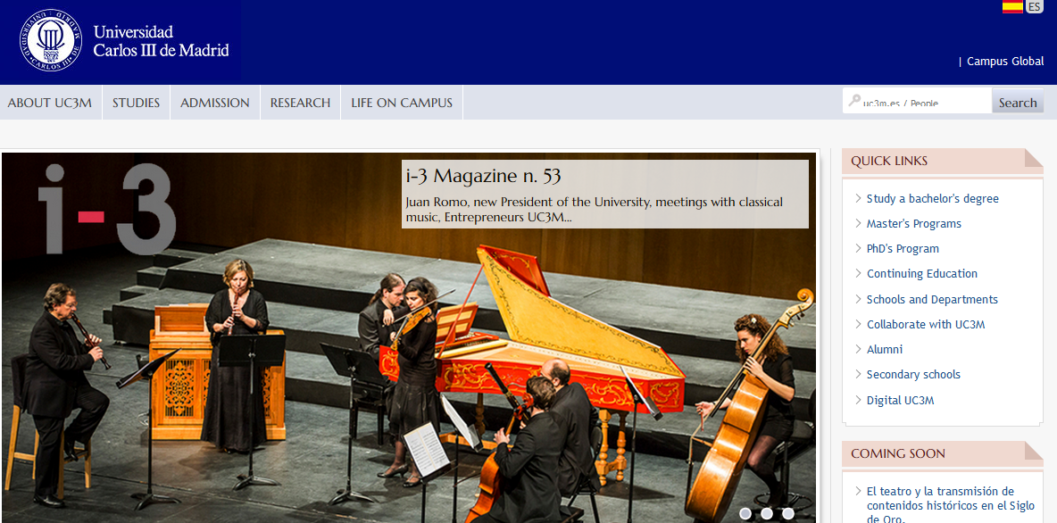
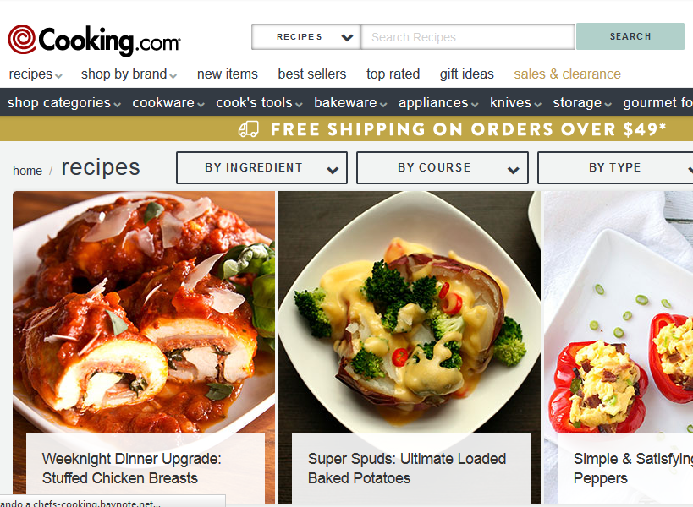
Introduction Proposal Recent Advances Next steps References
Introduction
Notes:
The Web has become the largest easy available repository of data. Hence, it is natural to extract information from it and Web search engines have become one of the most used tools in Internet.

Slide 3
Introduction Proposal Recent Advances Next steps References
Introduction (cont’d)
Classical Information Retrieval
Goal: Retrieve documents with information content that is relevant to a user’s query
Corpus: Fixed document collection. Usually small, controlled and nonlinked collections
Web Information Retrieval
Goal: Retrieve high quality pages that are relevant to user’s need
Corpus: The publicly accessible Web Largest and linked document collection

Slide 4
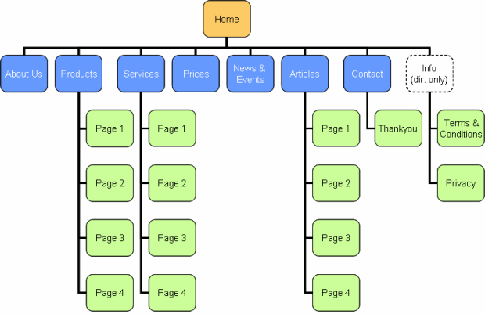
Introduction Proposal Recent Advances Next steps References
Proposal
Website
Spider
Document
corpus
Query String
IR
System
The spider represents the main difference compared to traditional IR.
1. Page1
2. Page2
3. Page3
.
.
Ranked
Documents
Notes:
The first thing you must notice, is that instead of trying to manage the information retrieval from all over the web, we will focus on a less ambitious case, managing information retrieval from a particular website.

Slide 5
Introduction Proposal Recent Advances Next steps References
Recent Advances
Text Preprocessing
Tokenization: separate the text into words called tokens
Removing stopwords to reduce the dimension of the vocabulary and to eliminate expressions that do not provide information (pronouns, prepositions, articles and conjunctions)
Creation of feature vectors
TF-IDF (Term Frequency-Inverse Document Frequency)
To carry out the text preprocessing we have used the library NLTK 3.0 (Natural Language Toolkit), which is a tool consisting of a collection of libraries and programs in python that allows for customization and optimization of NLP processes.

Slide 6
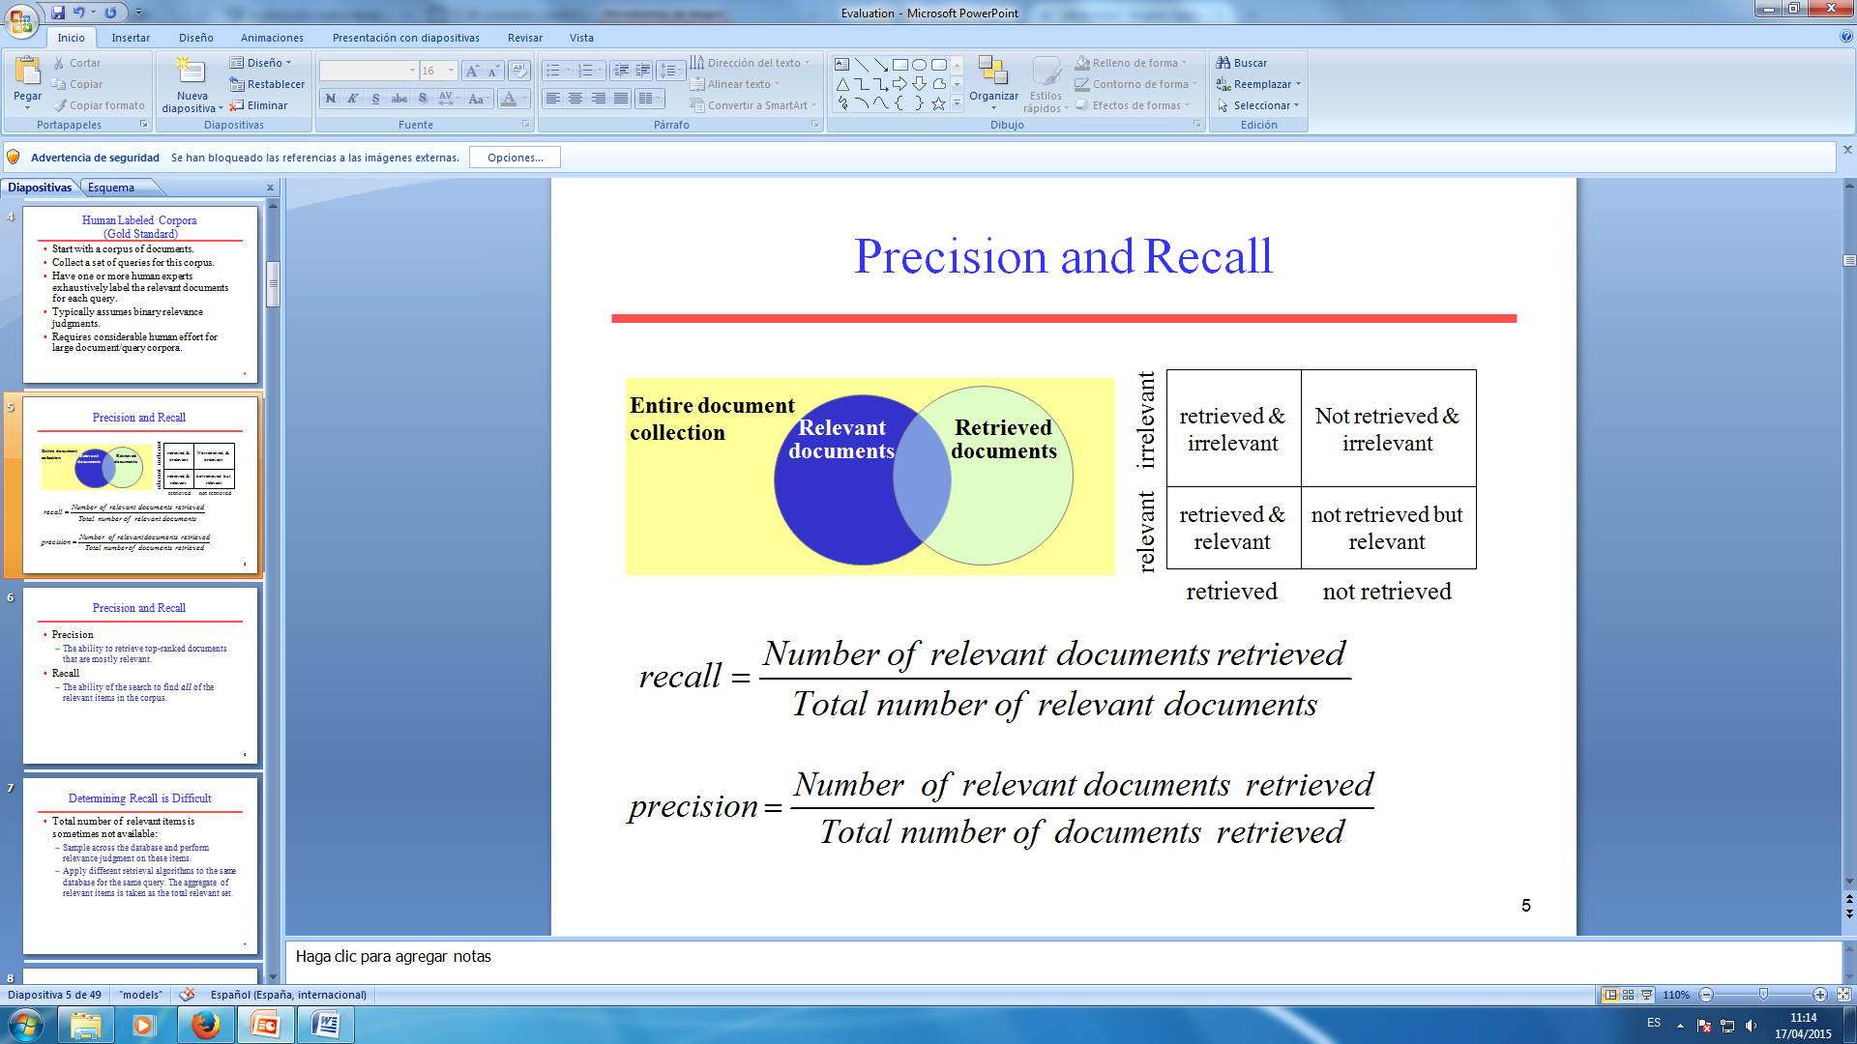



Introduction Proposal Recent Advances Next steps References
Next steps
Development of the Website crawler (Document corpus acquisition)
Download a web page using urllib (in Python)
Parsing HTML and XML documents using Beautiful Soup (a package in Python)
Integration of the whole system:
Document corpus acquisition + processing of text block + features extraction block + similarity block + ranked results
Retrieval evaluation
$$precision= \frac{Number of relevant pages retrieved}{Total number of pages retrieved}$$
$$recall= \frac{Number of relevant pages retrieved}{Total number of relevant pages}$$
Notes:
1. Hasta ahora las pruebas realizadas sobre el modulo de procesamiento de texto que hemos desarrollado se han hecho usando las bases de datos disponibles en NLTK.
2. Integration of the whole system
3. Finally, once we have finished our system in order to evaluate its performance, we will use Precision and Recall which are the basic measures used to evaluate the performance of information retrieval systems.

Slide 7
Introduction Proposal Recent Advances Next steps References
References
[1]
Brants, Thorsten. "Natural Language Processing in Information Retrieval." CLIN. 2003.
[2]
WU, Ho Chung, et al. Interpreting tf-idf term weights as making relevance decisions. ACM Transactions on Information Systems (TOIS), 2008, vol. 26, no 3, p. 13.
[3]
D. Jurafsky, C. Manning. “Natural Language Processing”. By Standford.
Coursera: https://class.coursera.org/nlp/lecture
[4]
Broder, Andrei. "A taxonomy of web search." ACM Sigir forum. Vol. 36. No. 2. ACM, 2002.
[5]
Mansourian, Yazdan. "Similarities and differences between web search procedure and searching in the pre-web information retrieval systems." Webology 1.1 (2004).
[6]
Langville, Amy N., and Carl D. Meyer. "Information retrieval and web search." Supported by National Science Foundation under NSF grant CCR-0318575, USA (2006).

